Slide 1
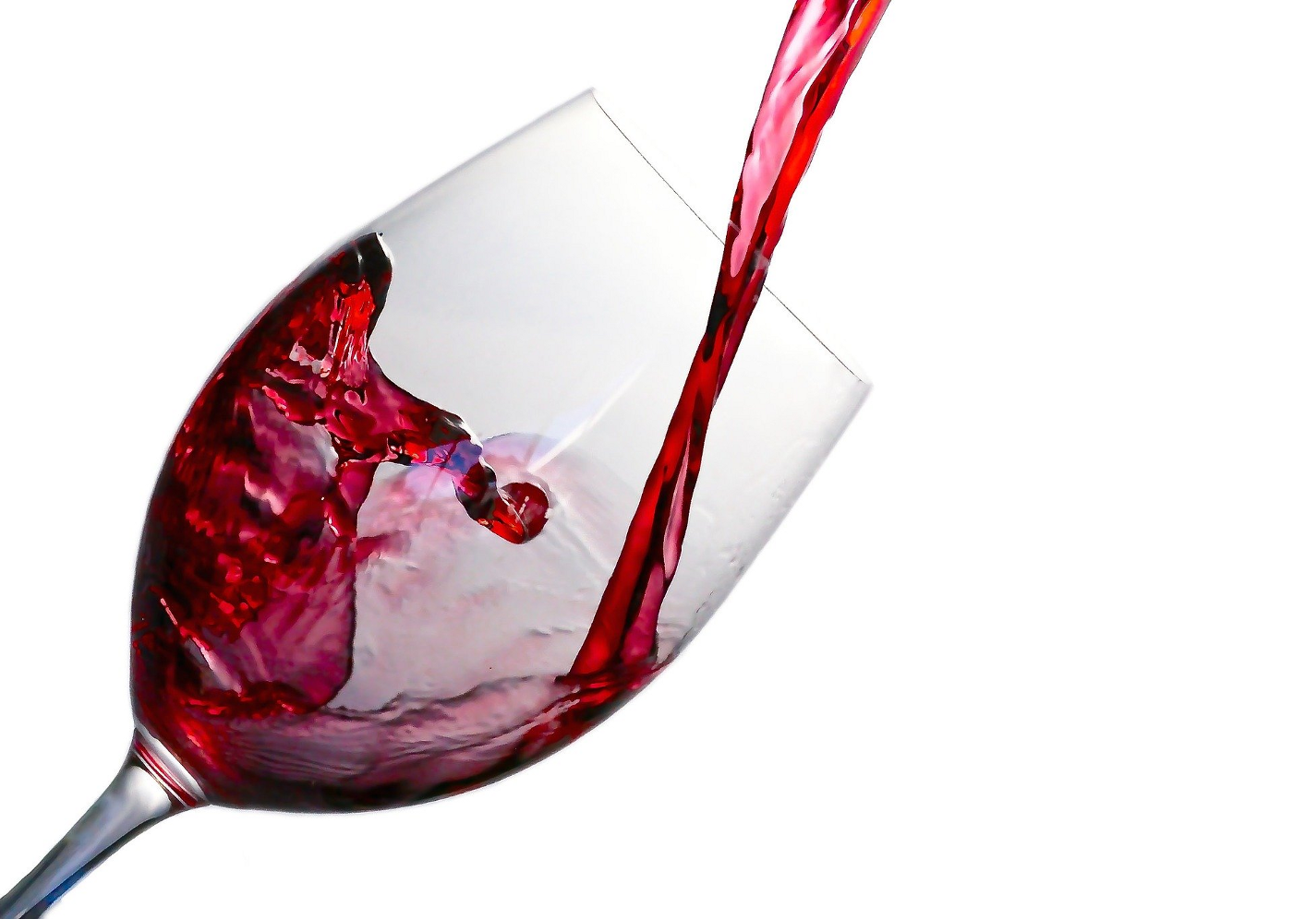
Red Wine Quality Prediction Using Machiene Learning Techniques PRESENTED BY : MANJIMA VARGHESE S3MCA ROLLNO:16

Slide 2
Introduction
Wine is an alcoholic beverage made with the fermented juice of grapes.
Quality of wine is graded based on the taste of wine and vintage.this process is time consuming,costly and not efficient
A wine itself include different parameters like fixed acidity,volatile acidity,citric acid,residual sugar,chlorides,free sulphur dioxide,total sulphur dioxide,density,ph,sulphates,alcohol and quality
In industries,understanding the demand of wine safety testing can be complex task for the laboratory with numerous analytes and resideus to monitor
But,our machiene learning prediction provide ideal solutions for the analysis of wine,which will make this whole process efficient and cheaper with less human interaction

Slide 3
Objectives of topic
Nowadays people try to lead a luxurious life. They tend to use the things either for show off or for their daily basis. These days the consumption of red wine is very common to all. So it became important to analyze the quality of red wine before its consumption to preserve human health
The red wine industry shows a recent exponential growth as social drinking is on the rise. Nowadays, industry players are using product quality certifications to promote their products.
The red wine market would be of interest if the human quality of tasting can be related to wine’s chemical properties so that certification and quality assessment and assurance processes are more controlled.
This project aims to the quality prediction of the red wine using its various attributes

Slide 4
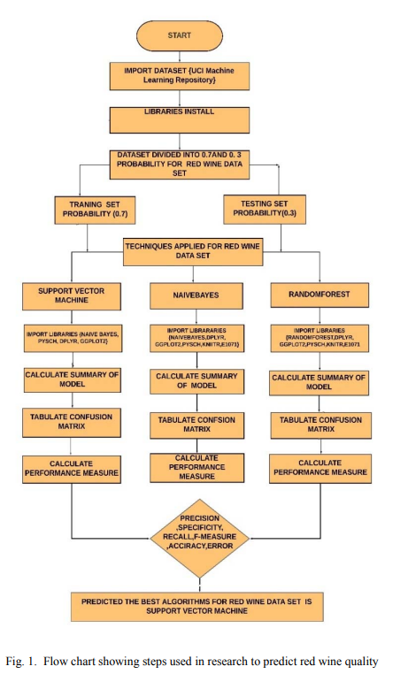
A description of the project

Slide 5
Exisisting system
The quality of the wine is a very important part for the consumers as well as the manufacturing industries. industries are increasing their sales using product quality certification.
Nowadays, all over the world wine is a regularly used beverage and the industries are using the certification of product quality to increases their value in the market.
Previously, testing of product quality will be done at the end of the production, this is time taking process and it requires a lot of resources such as the need for various human experts for the assessment of product quality which makes this process very expensive.
Every human has their own opinion about the test, so identifying the quality of the wine based on humans experts it is a challenging task.
Disadvantages:
The process is costly and time consuming.

Slide 6
Proposed system
In a proposed system, is a step towards the quality prediction of the red wine using its various attributes. dataset is taken from the sources and the techniques such as random forest, support vector machine and naïve bayes are applied.
Various measures are calculated and the results are compared among training set and testing set and accordingly the best out of the three techniques depending on the training set results is predicted.
Better results can be observed if the best features out from other techniques are extracted and merged with one another to improve the accuracy and efficiency.

Slide 7
Input/Output
INPUT
Input values are taken from the dataset
It consist of 12 attributes values such as
fixed acidity,citrus acid,volatile acidity,residual sugar,chlorides,thickness,free sulphur dioxide,pH, alcohol and sulphates.

Slide 8
OUTPUT
The output is the prediction of the quality of red wine
The outcome of the most accurate learning algorithm is shown as output.
The value of the output(quality) from 3 to 8
The number 3 indicates that low quality of fine was identified, while the value 8 indicates that a high quality wine is detected

Slide 9
Modules
Input module
Input is taken from the dataset which include the values of 12 attributes sich as fixed acidity,volatile acidity,pH,alcohol,free sulphur dioxide,total sulphur dioxide,density,citric acid,residual sugar,sulphates and quality
CLASSIFICATION MODULE
Prediction of red wine quality by naive bayes, random forest,support vector machiene algorithms.
EVALUATION MODULE
Analysis of performance of classifiers based on machine learning techniques and gives the predicted quality of red wine

Slide 10
System Specification
SOFTWARE SPECIFICATION
Operating system: Windows 11
Front end : HTML, CSS, JavaScript.
Back end : Python.
IDE : Google Collaboratory.
Web browser : Google Chrome.
HARDWARE SPECIFICATION
Processor : 11th Gen Intel(R) Core(TM) i3-1115G4 @ 3.00GHz 3.00 GHz
Hard disk : 1 TB
RAM : 8.00 GB
Monitor :15.6” W LED DISPLAY

Slide 11
A description of methodology or system design or algorithms to be used
Three algorithm is used to predict red wine quality where all of them uses different classification techniques.
Accuracy of each of the algorithm is drawn out using confusion matrix and corresponding classification report is also generated.
Techniques used are as given below.

Slide 12
• Naive Bayes Algorithm:
Naïve Bayes algorithm is a supervised learning algorithm, which is based on Bayes theorem and used for solving classification problems.
Naïve Bayes Classifier is one of the simple and most effective Classification algorithms which helps in building the fast machine learning models that can make quick predictions.
It is a probabilistic classifier, which means it predicts on the basis of the probability of an object.

Slide 13
Support Vector Machine:
This technique was taken from factual learning theory by Vapnik and Chervonenkis.
This technique is utilized for the characterization of both nonlinear and linear information. It utilizes a nonlinear mapping to change the primary preparing information into a higher estimation.
It scans for the linear optimal isolating hyperplane in this new estimation.
A hyperplane can isolate information from two classes, with a reasonable nonlinear mapping to adequately high estimation.
The SVM uses support vectors and edges to find this hyperplane.
A SVM model is a portrayal of the models as point in space, mapped with the goal that instances of the different classes are isolated by a gap that is as wide as would be prudent.
SVM can play out a nonlinear type of classification.

Slide 14
Random Forest:
Random Forest algorithms are used for classification as well as regression.
It creates a tree for the data and makes prediction based on that.
Random Forest algorithm can be used on large datasets and can produce the same result even when large sets record values are missing.
In random forest there are two stages, firstly create a random forest then make a prediction using a random forest classifier created in the first stage.

Slide 15
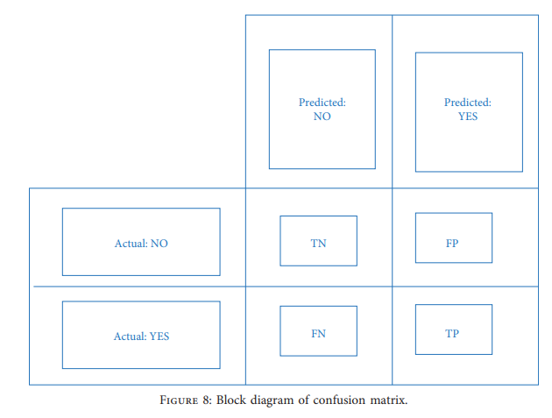
Confusion matrix
A confusion matrix is a table that is often used to describe the performance of a classification model (or "classifier") on a set of test data for which the true values are known.

Slide 16
Tools, Frameworks or Programming Language(s) etc.
Front end and Backend tools:
front end : html,css,javascript
back end : python
Working environment:
google colab and PyCharm

Slide 17
Datasets if any.
Here we used the red wine quality prediction dataset that is available in the kaggle website for our analysis. This dataset consists of total 12 attributes. The complete description of the attributes used in the proposed work is given below:
Input variables (based on physicochemical tests): 1 - fixed acidity : Non-volatile acids that don’t evaporate easily 2 - volatile acidity : acetic acid content which leading to an unpleasant vinegar taste 3 - citric acid : acts as a preservative to increase acidity 4 - residual sugar : amount of sugar remains after fermentation stops 5 – chlorides : Amount of salt

Slide 18
6 - free sulfur dioxide : It prevent microbial growth and the oxidation of wine 7 - total sulfur dioxide : Amount of SO2(Sulphur Dioxide) 8 – density : Sweeter wines have a higher density 9 – pH : Level of acidity 10 – sulphates : A wine addictive that contributes to SO2 levels and acts as an antimicrobial and antioxident 11 – alcohol : Amount of alocohol in wine Output variable (based on sensory data): 12 - quality (score between 3 and 8)

Slide 19
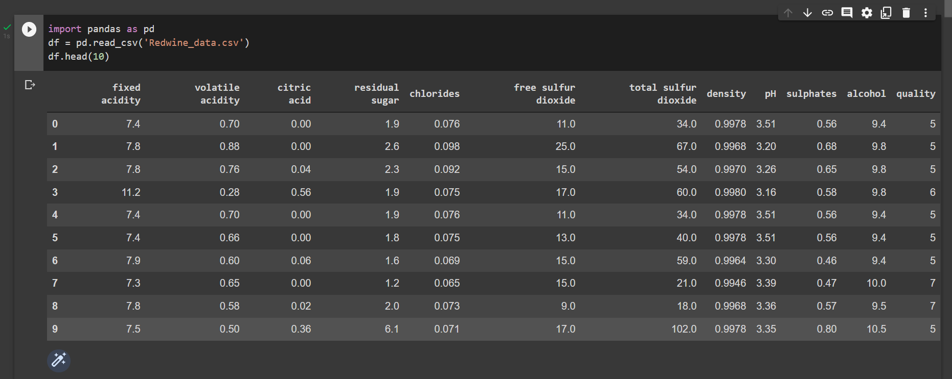
Code screeshots

Slide 20
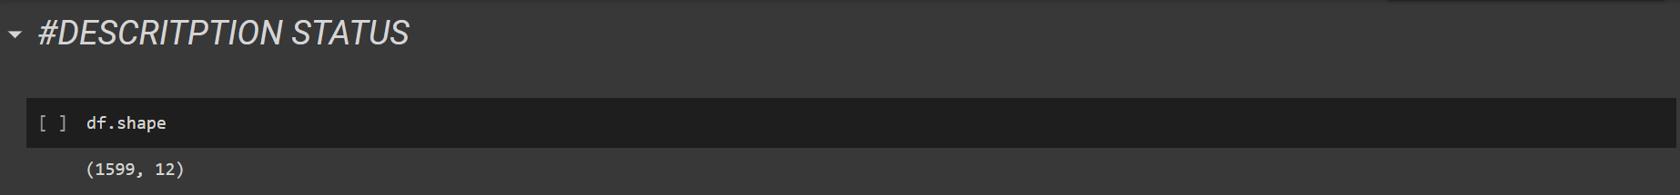
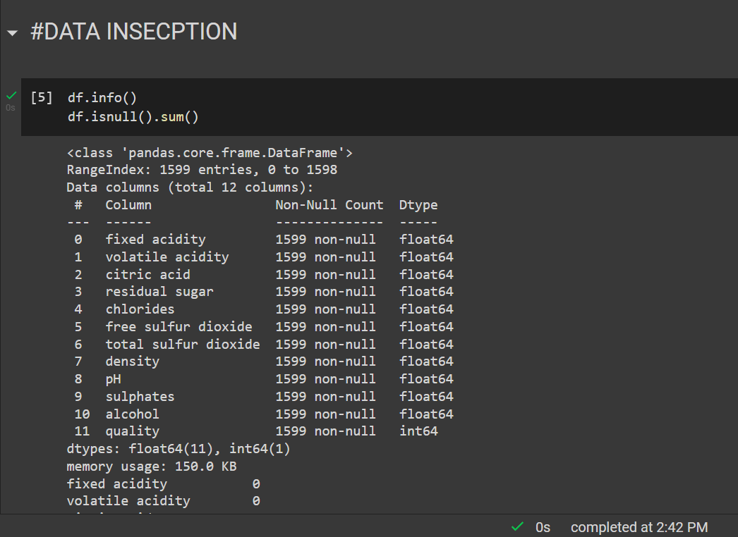

Slide 21
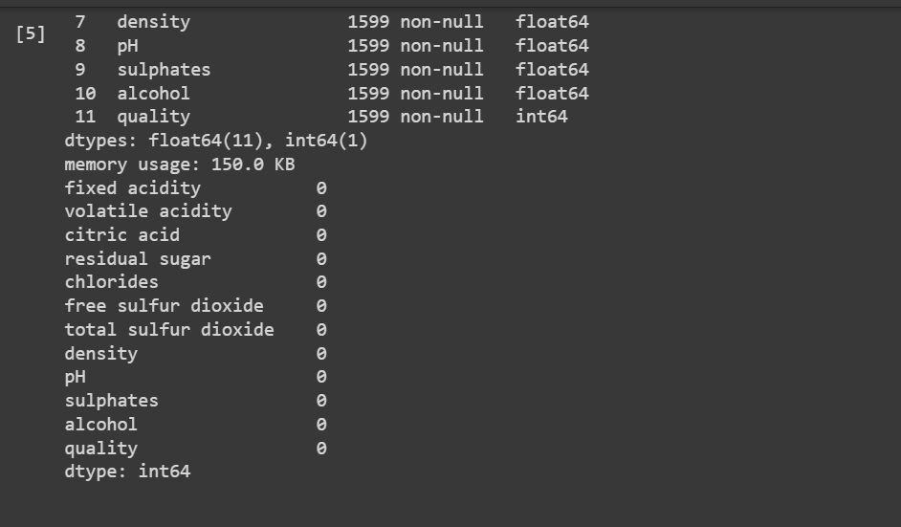

Slide 22
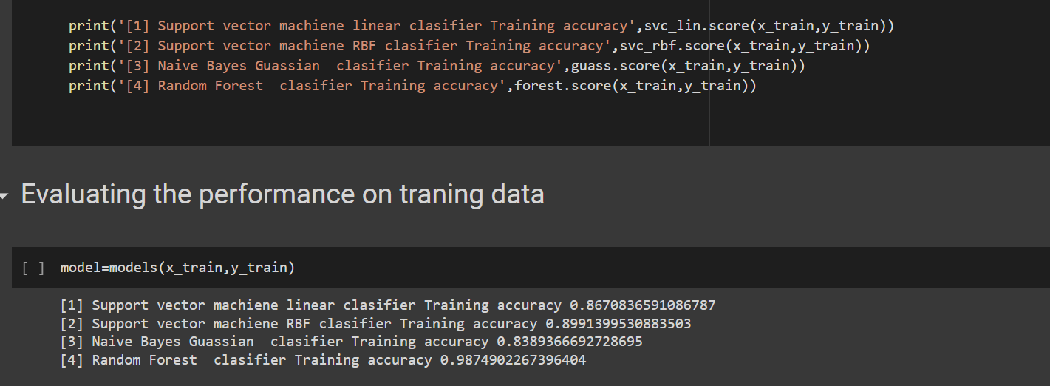
Algorithm
Prediction on Traning Data

Slide 23
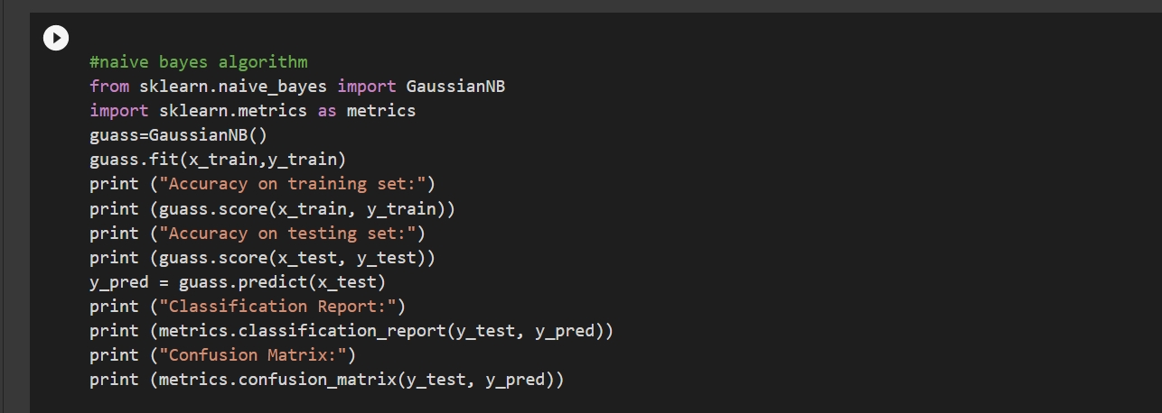
Prediction on testing data

Slide 24
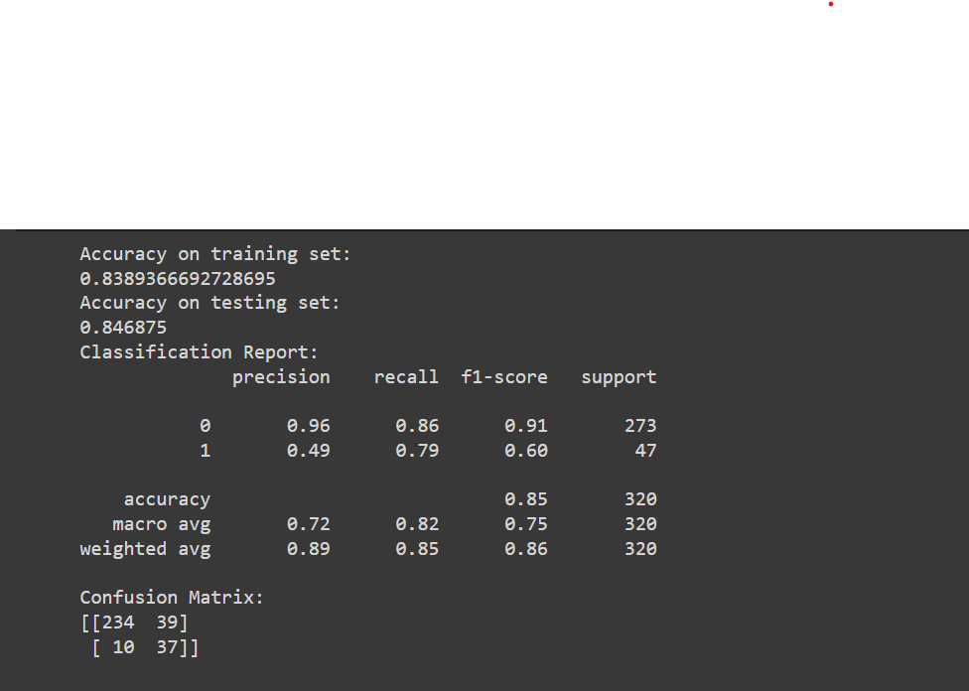

Slide 25
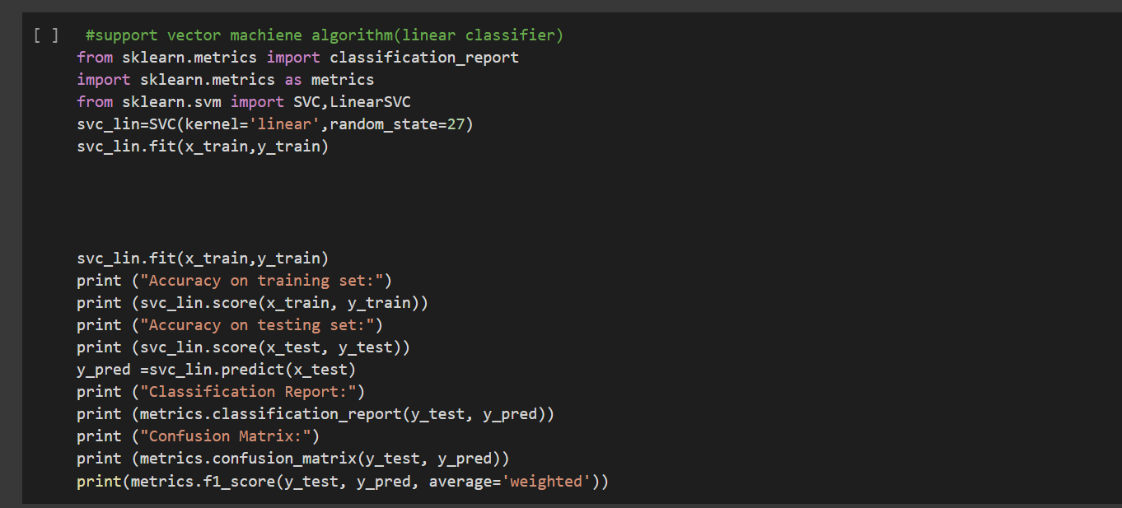

Slide 26
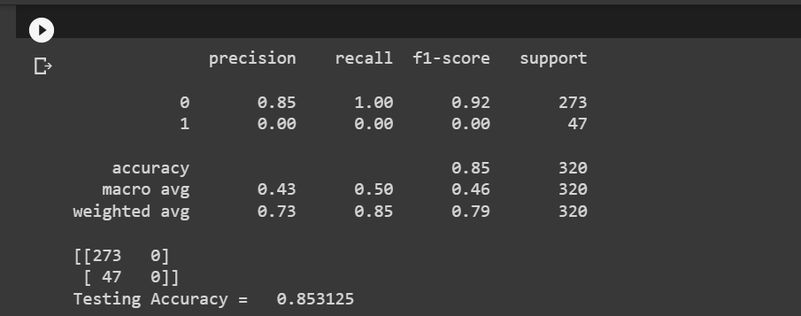

Slide 27
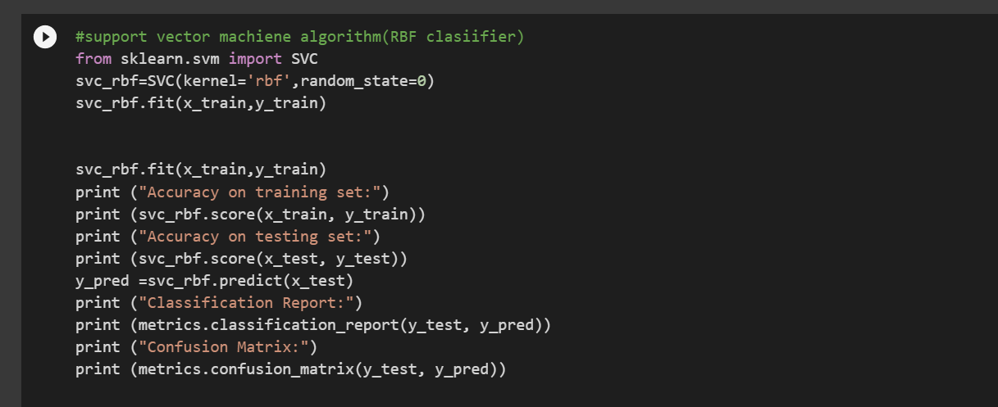

Slide 28
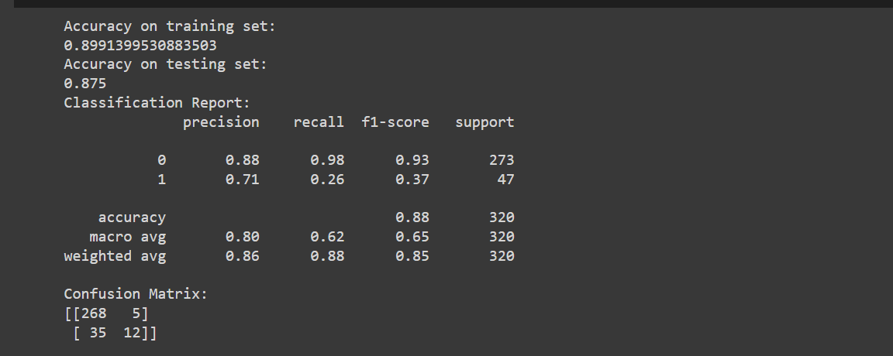

Slide 29
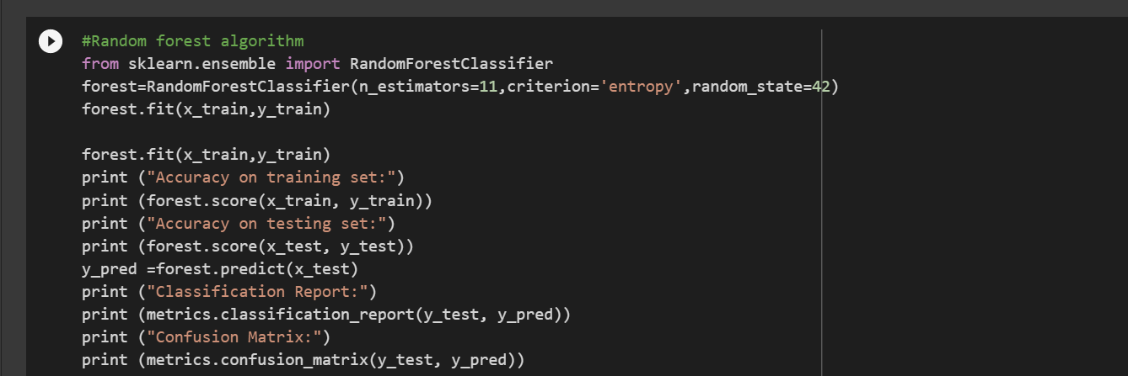

Slide 30
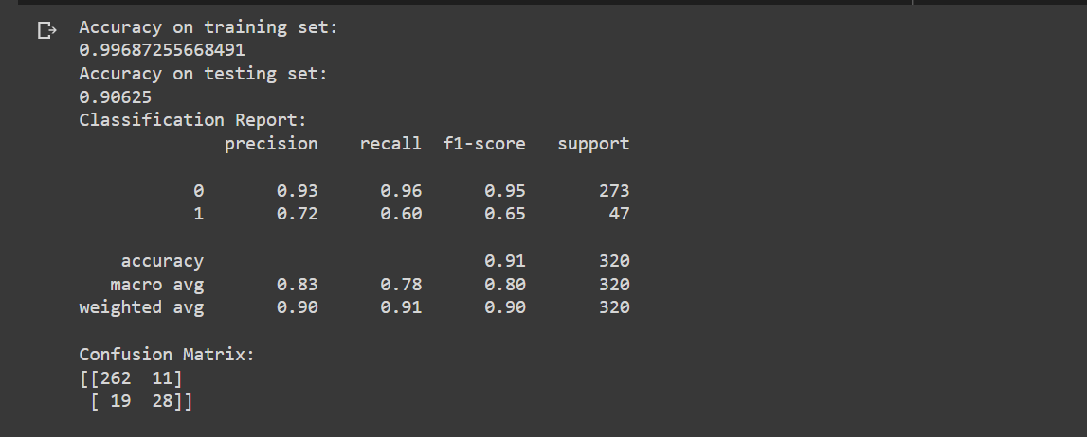

Slide 31
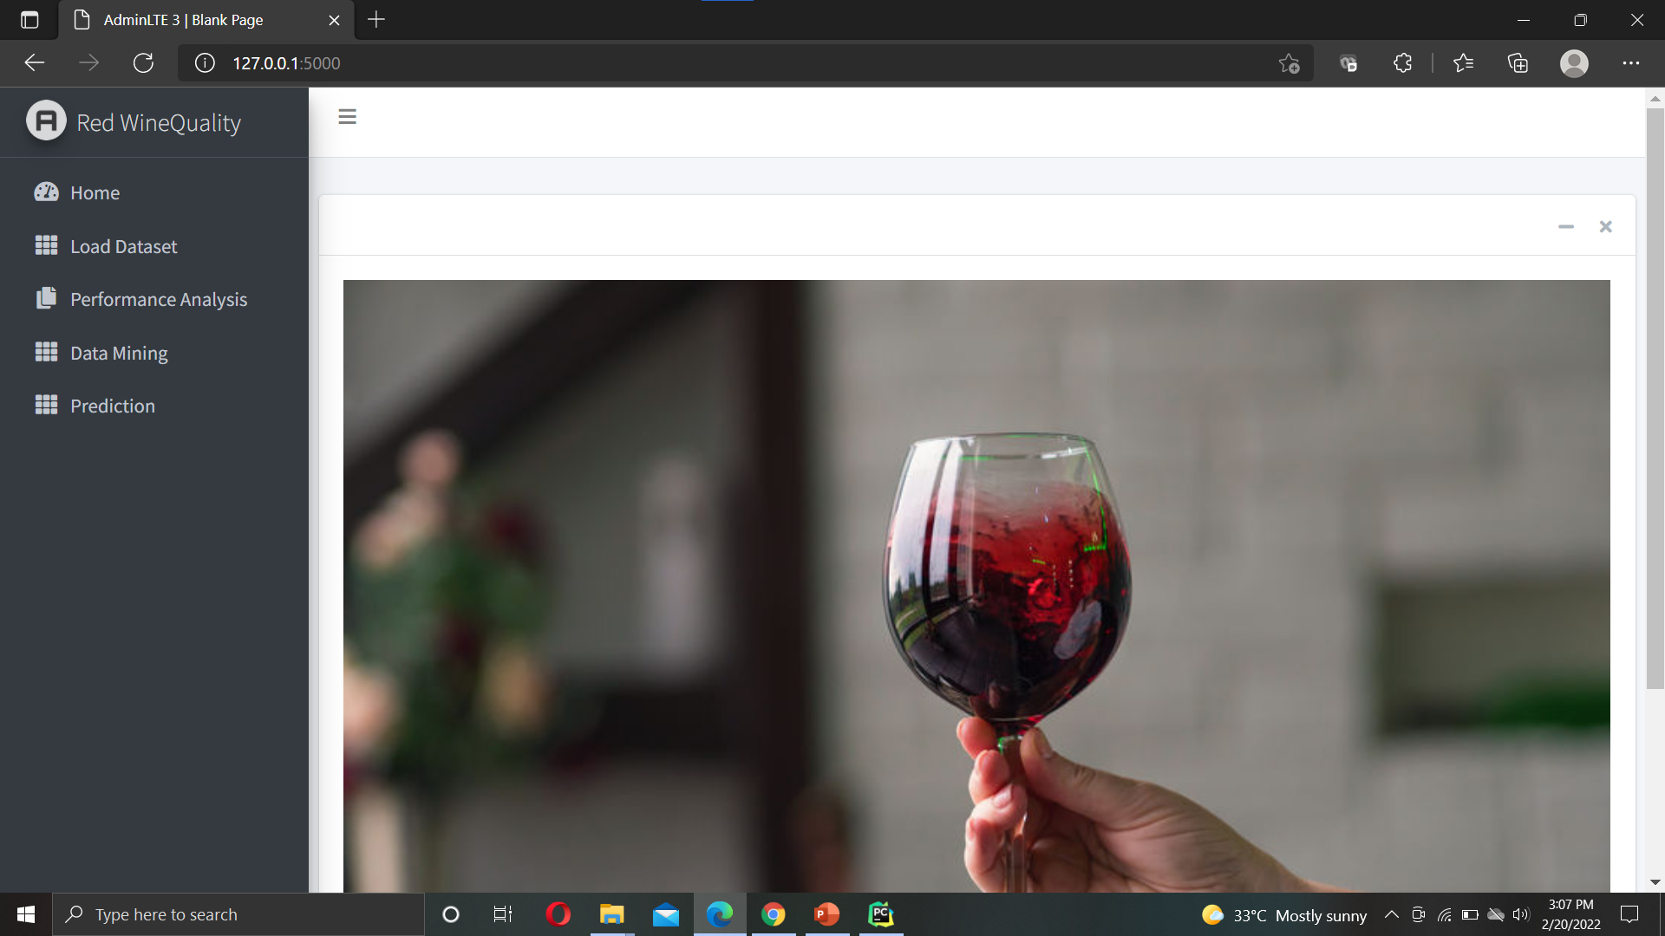
Main Page (UI)

Slide 32
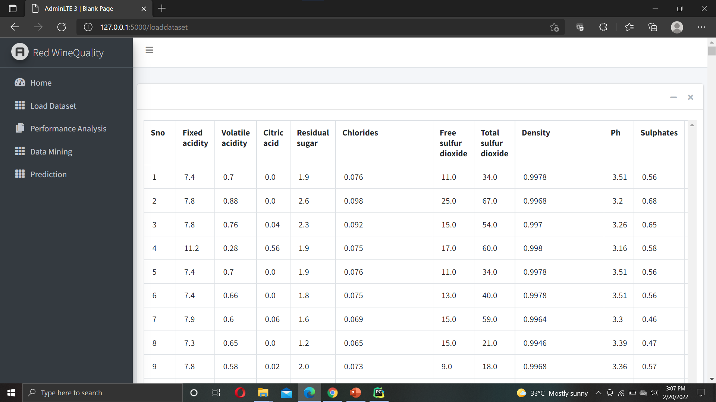
DATA SET

Slide 33
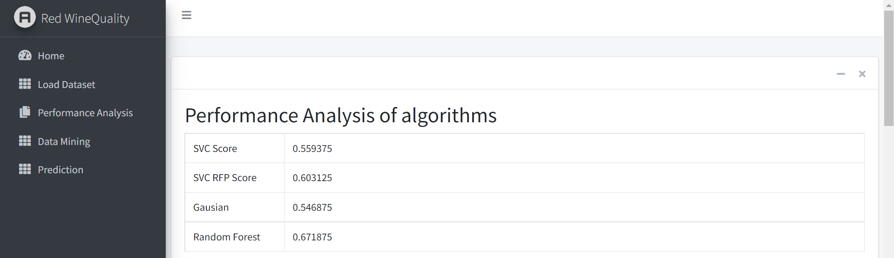
Performance analysis

Slide 34
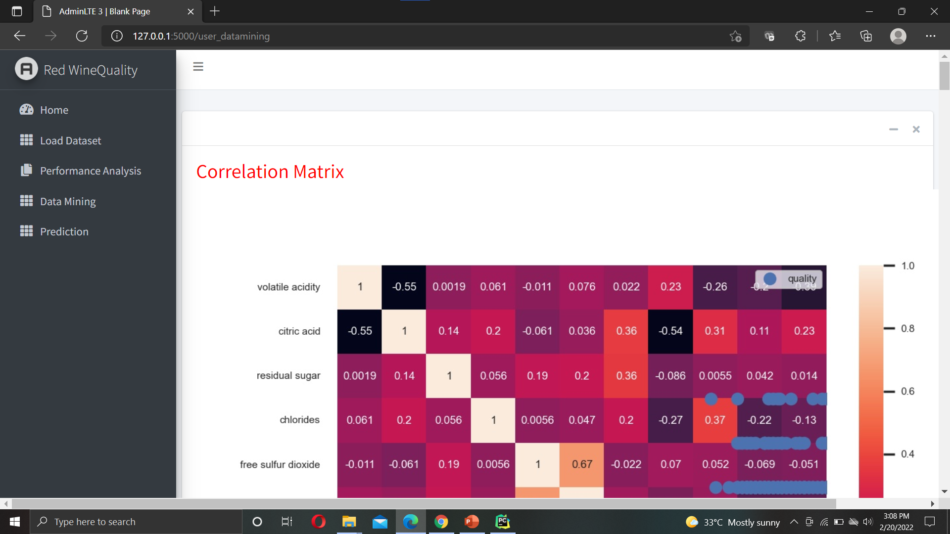
Data mining

Slide 35
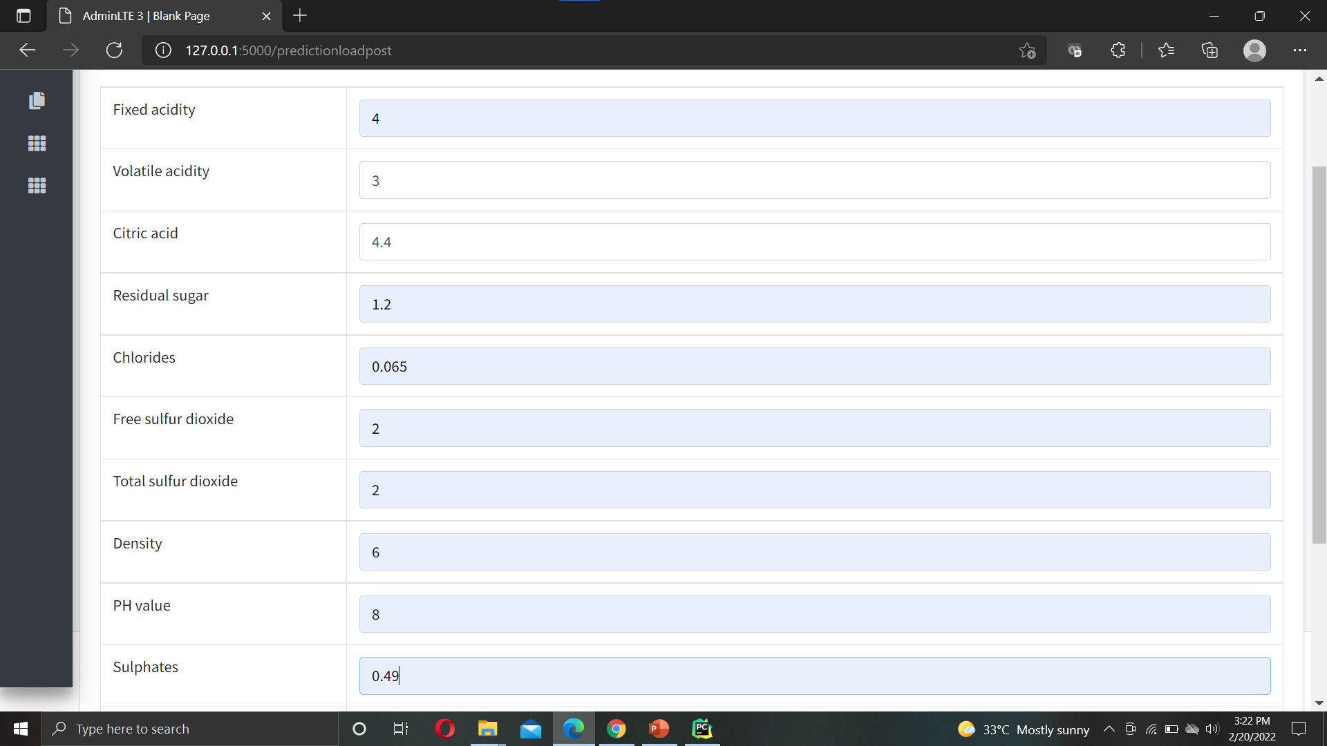

Slide 36
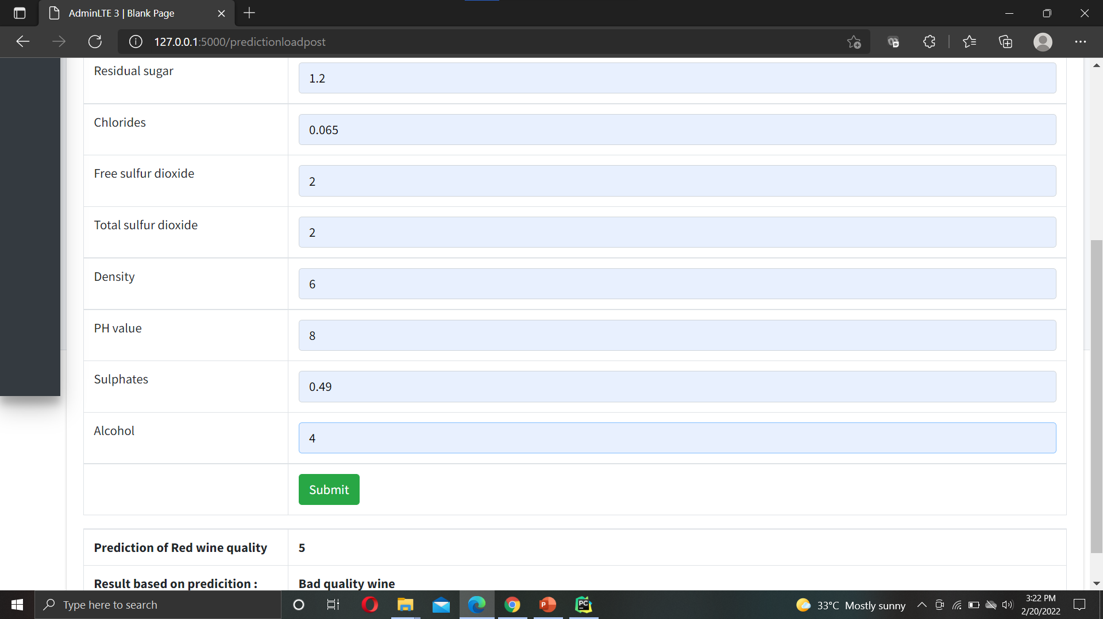

Slide 37
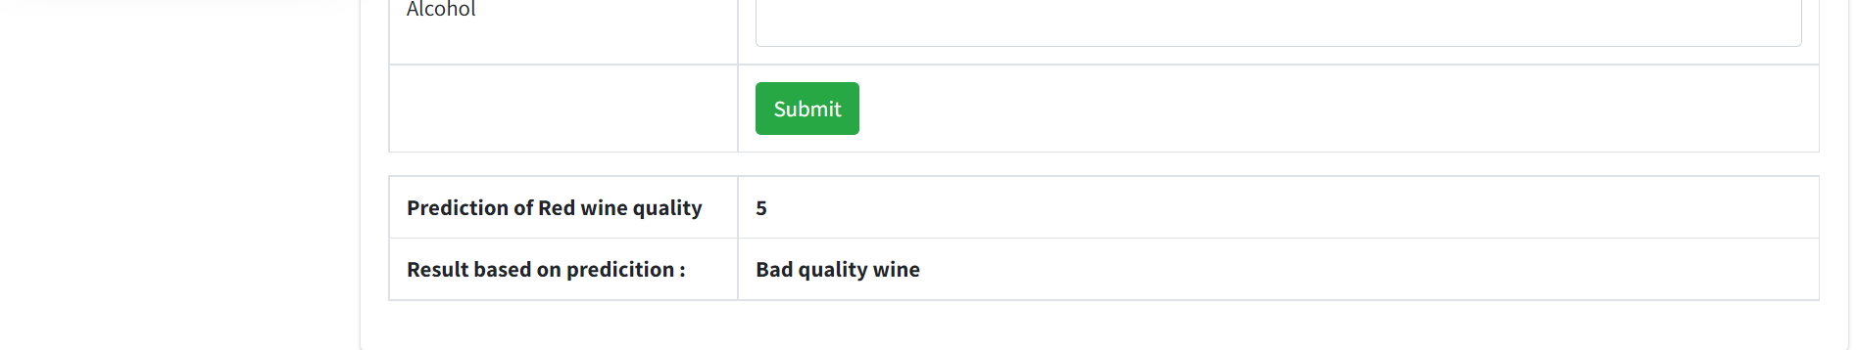
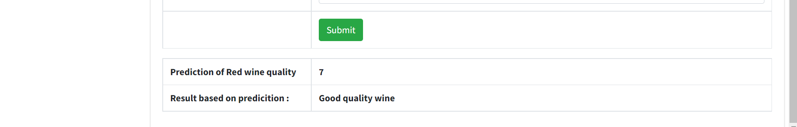

Slide 38
Flask
Flask is a micro web framework written in Python. It is classified as a microframework because it does not require particular tools or libraries. Advantages of using Flask framework are: There is a built-in development server and a fast debugger provided. It supports extensions that can add application features. Prototype used to create instances of web application.

Slide 39
Future scope
In the future, to improve the accuracy of the classifier, it is clear that the algorithm or the data must be adjusted. We recommend feature engineering, using potential relationships between wine quality, or applying the boosting algorithm on the more accurate method.
In addition, by applying the other performance measurement and other machine learning algorithms for the better comparison on results. This study will help the manufacturing industries to predict the quality of the different types of wines based on certain features, and also it will be helpful for them to make a good product.

Slide 40
Research paper and References.
Research paper :
S. Kumar, K. Agrawal and N. Mandan, "red wine quality prediction using machine learning techniques," 2020 international conference on computer communication and informatics (iccci), 2020, pp. 1-6, doi: 10.1109/iccci48352.2020.9104095.
References:
[1] p. cortez, a. cerderia, f. almeida, t. matos, and j. reis, “modelling wine preferences by data mining from physicochemical properties,” in decision support systems, Elsevier.
(2): 547-553. issn: 0167-9236. [2] s. ebeler, “linking flavour chemistry to sensory analysis of wine,” in flavor chemistry, thirty years of progress, kluwer academic publishers, 1999, pp. 409-422.
[3] v. preedy, and m. l. r. mendez, “wine applications with electronic noses,” in electronic noses and tongues in food science, cambridge, ma, usa: academic press, 2016, pp. 137-151.

Slide 41
[4] A. Asuncion, and D. Newman (2007), UCI Machine Learning Repository, University of California, Irvine, [Online]. Available: http://www.ics.uci.edu/~mlearn/MLRepository.html
[5] S. Kallithraka, IS. Arvanitoyannis, P. Kefalas, A. El-Zajouli, E. Soufleros, and E. Psarra, “Instrumental and sensory analysis of Greek wines; implementation of principal component analysis (PCA) for classification according to geographical origin,” Food Chemistry, 73(4): 501-514, 2001.

